Slide 1


Statistical Modelling with Data
May 23 – June 02, 2023
Instructor: Qing (Leah) Li, Ph.D. Candidate at Cumming School of Medicine
qing.li2@uclagary.ca
Thank you Dr. Thuntida Ngamkham for contributing the contents
Thank you Dr. Qingrun Zhang and Dr. Quan Long for contributing some slides

Slide 2
Statistical Modelling with Data
Topic 1: Statistical Modelling
Lecture 1: First-order models with quantitative independent variables
Topic 2: Statistical Modelling with interactions (Assignment 1)
Lecture 2: Interaction effects, quantitative and qualitative variables
Lecture 3: Interaction effects and second-order models
Topic 3: Statistical Model selection (Assignment 2)
Lecture 4: Model selection: Stepwise regression procedures
Lecture 5: Model selection: Forward and Backward selection procedures
Topic 4: Statistical model diagnostics
Lecture 6: Multiple regression diagnostics: verify linearity, independence, and equal variance assumptions.
Lecture 7: Multiple regression diagnostics: verify normality assumptions and identify multicollinearity and outliers.
Lecture 8: Multiple regression diagnostics: data transformation
Topic 5: Transfer learning
Lecture 9: Transfer-learning (Bonus): standing on the shoulders of giants.

Slide 3
Statistical Modelling with Data
Topic 1: Statistical Modelling
Lecture 1: First-order models with quantitative independent variables
Topic 2: Statistical Modelling with interactions (Assignment 1)
Lecture 2: Interaction effects, quantitative and qualitative variables
Lecture 3: Interaction effects and second-order models
Topic 3: Statistical Model selection (Assignment 2)
Lecture 4: Model selection: Stepwise regression procedures
Lecture 5: Model selection: Forward and Backward selection procedures
Topic 4: Statistical model diagnostics
Lecture 6: Multiple regression diagnostics: verify linearity, independence, and equal variance assumptions.
Lecture 7: Multiple regression diagnostics: verify normality assumptions and identify multicollinearity and outliers.
Lecture 8: Multiple regression diagnostics: data transformation
Topic 5: Transfer learning
Lecture 9: Transfer-learning (Bonus): standing on the shoulders of giants.
Notes:
The first lecture does not frighten you. I hope you can still bare with my English with accents for the rest of courses.
Many I ask some of your feedbacks for yesterday’s courses? You know these courses won’t be graded and all we ask is to attend six lectures to get the certificate. However, there must be something more than certificate you want to get from this course. I hope that I can really help you understand some basics of statistical modelling. I am not sure what’s your exceptions from this course.

Slide 4
Statistical Modelling with Data
Learning Outcomes: At the end of the course, participants will be able to
Model the multiple linear relationships between a response variable (Y) and all explanatory variables (both categorical and numerical variables) with interaction terms. Interpret model parameter estimates, construct confidence intervals for regression coefficients, evaluate model fits, and visualize correlations between a response variable (Y) and all explanatory variables (X) by graphs (scatter plot, residual plot) to assess model validity.
Predict the response variable at a certain level of the explanatory variables once the fit model exists.
Implement R-software and analyze statistical results for biomedical and other data.
Evaluations
Assignments will be posted on Slack (our communication tool with students).
Students must attend 70% (6/9) of the sessions in order to receive the certificate and are encouraged to work on the assignments progressively throughout the course as the relevant material is covered.

Slide 5

Statistical Modelling with Data
Supportive materials
Lectures slides (2023)
R code scripts (2023)
PDF (dated 2022)
Two Assignments (dated 2022)
Slack channels
Recoding videos
Exercises
Course-documents

Slide 6

Lecture 2: Multiple Linear Regression Interaction effects, quantitative and qualitative variables

Slide 7
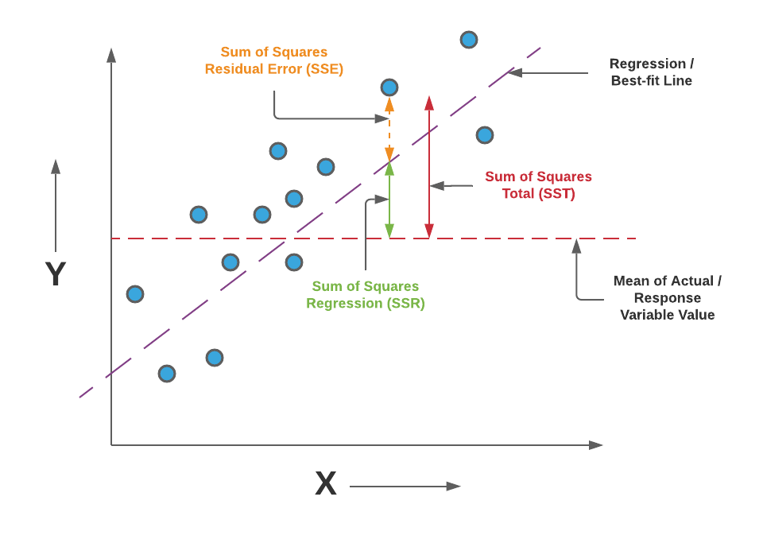
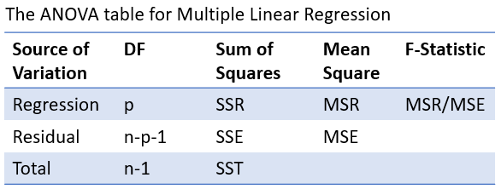
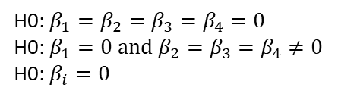
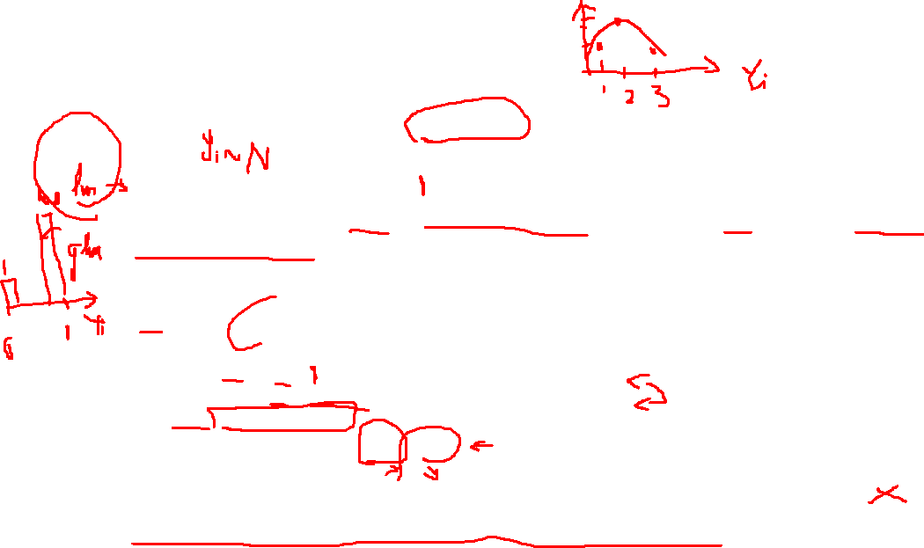
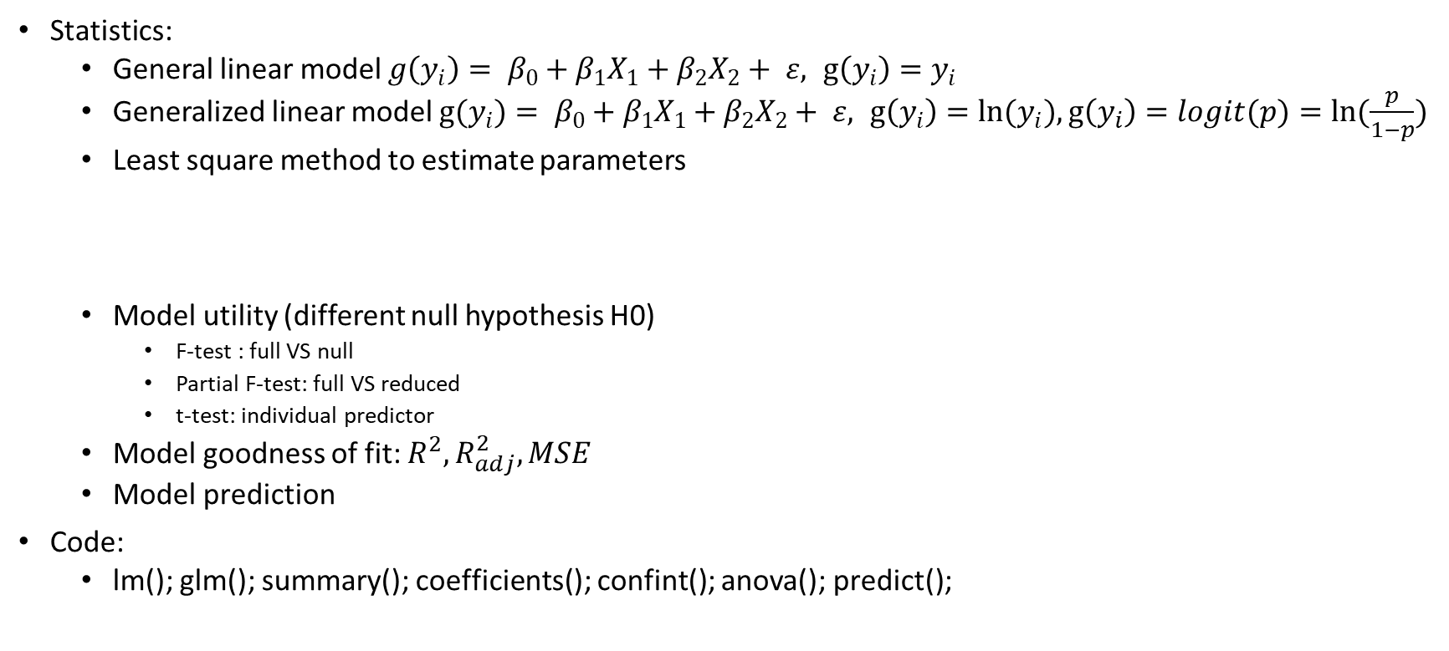
Quick recap of lecture 1
response, coefficients, predictors
Statistics:
General linear model $g\left(y_{i}\right)= β_{0}+β_{1}X_{1}+β_{2}X_{2}+ ε, g\left(y_{i}\right)=y_{i}$
Generalized linear model ${g(y}_{i})= β_{0}+β_{1}X_{1}+β_{2}X_{2}+ ε, g\left(y_{i}\right)={ln(y}_{i}),g\left(y_{i}\right)=logit(p)=ln⁡(\frac{p}{1−p})$
Least square method to estimate parameters
Model utility (different null hypothesis H0)
F-test : full VS null
Partial F-test: full VS reduced
t-test: individual predictor
Model goodness of fit: $R^{2}, R_{adj}^{2}, MSE$
Model prediction
Code:
lm(); glm(); summary(); coefficients(); confint(); anova(); predict();
H0: $β_{1}=β_{2}=β_{3}=β_{4}=0$
H0: $β_{1}=0 and{ β}_{2}=β_{3}=β_{4}≠0$
H0: $β_{i}=0$
Notes:
For some of you, it may be a piece of cake. For some of you, it’s understandable but takes some time to fully digest. For some of you, it may be a little bit too much to digest.
Don’t worry, at the beginning of the lecture, I will help you quickly recap the key points for the previous lecture, and we will do the same for all the rest lectures. If you manage to understand most of the key points you are all good to move forward with lecture the next lecture. If you do have some difficulties in understanding some points, please feel free to approach me during the class break or after class, usually we have about 15 minutes at the end to discuss anything you want. Remember, I am not here to evaluate your knowledge or your coding skills, I am here to support you every step of the way. So, I am more than happy to make any knowledge points into an easier understanding way for you personally.
So for lecture 1, we talked about building general linear model, this kind of model can contain one predictor or multiple predictors. But it only has one response. The general linear model has its limitations and the major one is it assume your response follows a normal distribution. This mean the are a lot of moderate values but quite a few extreme large or small value. To overcome such limitation, we can use generalized linear model. In generalized linear model we will do some transformation on Y to make the transformed Y approximately follows a normal distribution. Then we talked about that building statistical model equals to getting estimated values for coefficients of predictor. The most common approach is to use least square method. This means we use write a function of betas, which is called LSE and we minimize this LSE function to find the optimal betas. When you thinking a bout regression, please think about this figure. You have blue dots represent … purple long dash line represent… red shot dash line represent. Based on these information, you can have some calculations about SSE, SSR, SST.
Ok, we now know general linear model, generalized linear model, least square method to estimate coefficient of predictors. Then we speak about testing model utility. We covered three tests. F-test … Partial F-test… T-test. These three test have different null hypothesis. You may not need to bear
all these null hypotheses in mind. But please remember that these are in different circumstance. F-test is used to test full model against null model. By saying full model I mean … By saying a null model I mean. Similar, partial F-test is also a F-test but it is used to test full model against a reduced model. While doing F-test, we can build this ANOVA table to help us calculating F-test statistic. Of course, you can also use R or other online tool to do that.
A t-test to test the coefficient of each predictor.
At the end of the lecture, we learned how to evaluate the goodness of fit for models using R2, Radj2, MSE. Here are the list of R function you which I hope you can learn by heart.

Slide 8
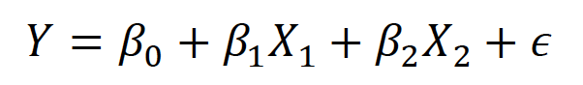
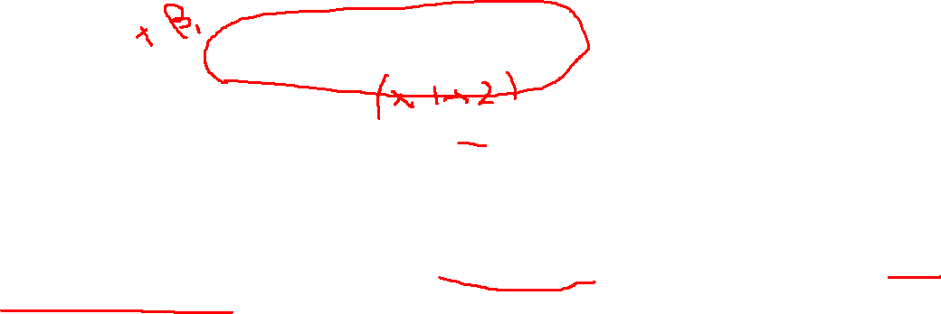
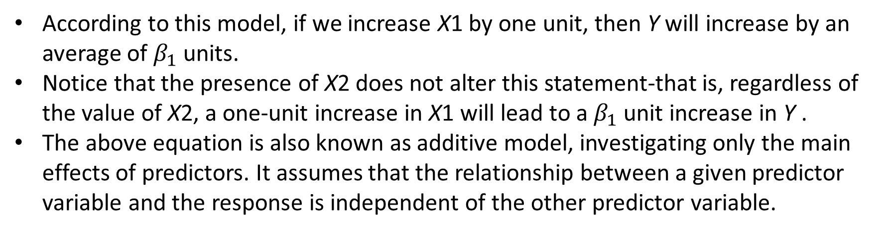
An Interaction Model with Quantitative Predictors
Standard linear regression model
According to this model, if we increase X1 by one unit, then Y will increase by an average of $β_{1}$ units.
Notice that the presence of X2 does not alter this statement-that is, regardless of the value of X2, a one-unit increase in X1 will lead to a $β_{1}$ unit increase in Y .
The above equation is also known as additive model, investigating only the main effects of predictors. It assumes that the relationship between a given predictor variable and the response is independent of the other predictor variable.
8
Notes:
Let's take a closer look at the multivariate linear regression model.

Slide 9



An Interaction Model with Quantitative Predictors
+ interactions
Family wellness = health + wealth + wife + husband + kids
Each predictor is known as term in statistics
Predictor = term = variable
9
Notes:
I think we all agree that a harmonious family play an important role in our life and work. This is an ideal happy family looks like. However, in reality, there are a lot interactions between family members, especially young kids. Their interactions will more or less affect your mood. Therefore, whiling building models to estimate family wellness, please bear in mind to add this interactions terms. I found sometimes it can be more important than any other terms.

Slide 10
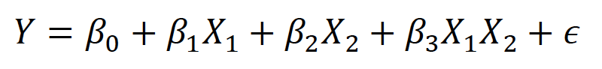

An Interaction Model with Quantitative Predictors
Interaction occurs when the influence of an independent variable on a dependent variable is not consistent across all independent variable values.
In this case, we need another model that will take into account this dependence. Such a model includes the cross products of two or more X’s.
Hence, the interaction model for two variables looks like below:
10
Notes:
So, in today’s lecture, we will focus on working with interactions between variables and building statistical models with interaction.
From the point view of a statistician or mathematician, Interaction occurs when the influence of an independent variable on a dependent variable is not consistent across all independent variable values.

Slide 11
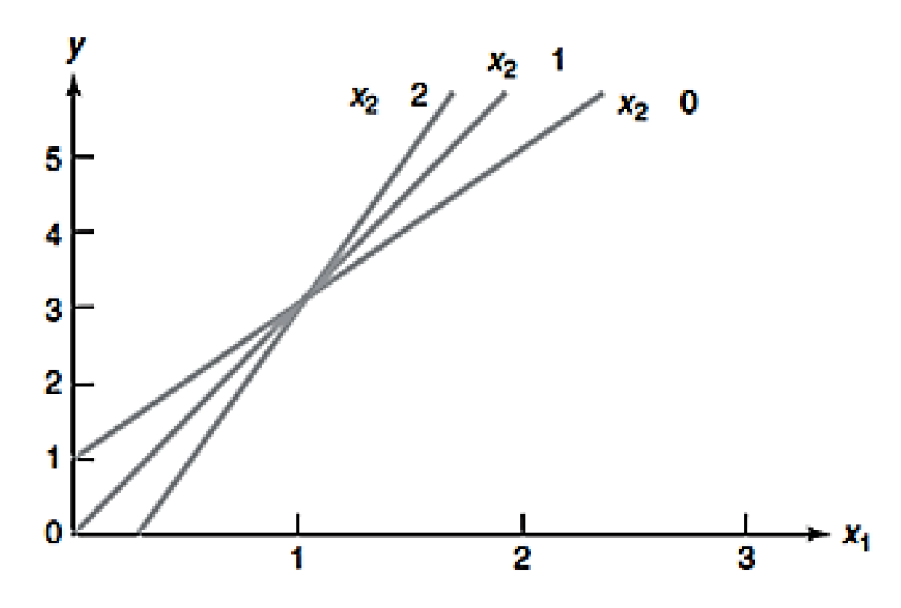
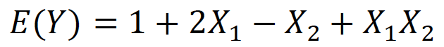
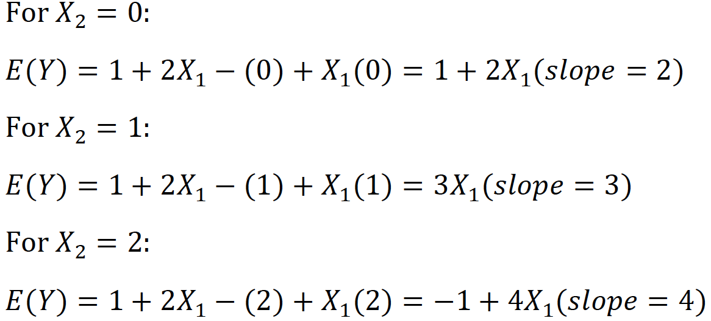
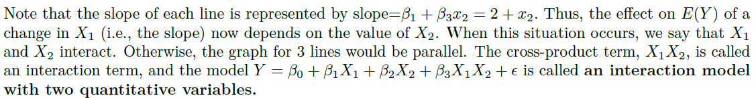

An example
Influence of the independent variable X1 on the dependent variable Y is not consistent across X2 values!
11
Notes:
Here a detailed example of an interaction model and let’s take a closer look at why influence of the independent variable X1 on the dependent variable Y is not consistent across X2 values.

Slide 12
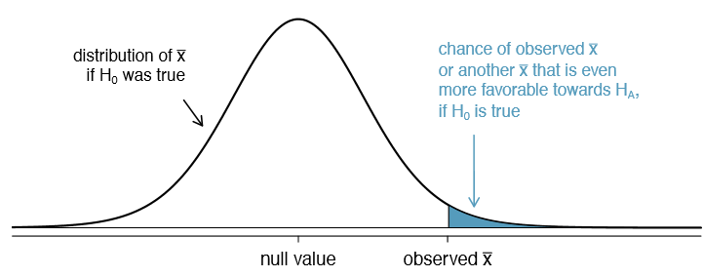
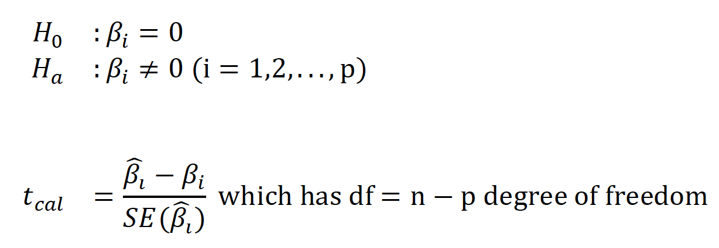

Testing for Interaction in Multiple Regression
For testing an interaction term in regression model, we use the Individual Coefficients Test (t-test) method.
If the p-value for the t test statistic is extremely little (typically less than 0.05), it implies that our test statistic is unlikely to come from a null distribution. As a result, we can reject the null hypothesis with a little chance (alpha) of making mistakes. This also means that we accept the alternative hypothesis, and that the interaction term is critical in our statistical model.
12
Notes:
What an interaction term is and how to construct an interaction term. We may further think whether this interaction term is necessary. To answer this question, we back to t-test. If you remember from yesterday’s lecture, we conduct t-test to evaluate whether the coefficient of each predictor is significantly different from 0 or not.

Slide 13
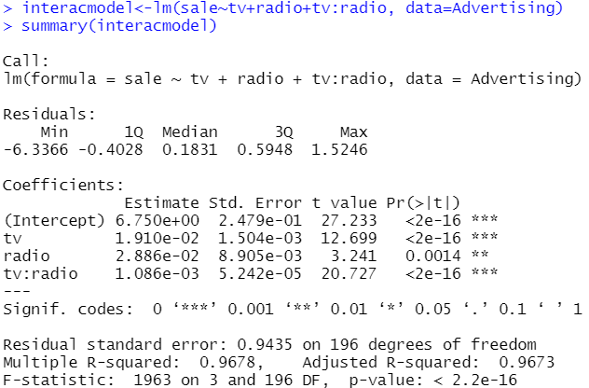
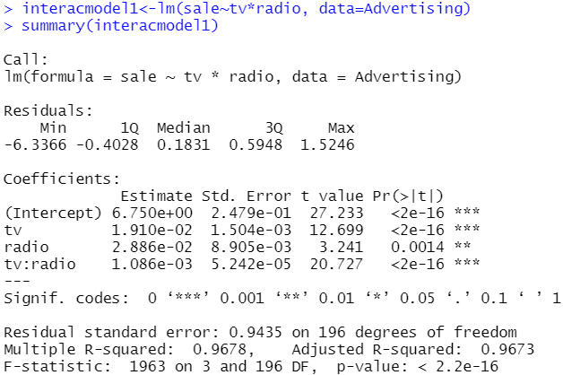
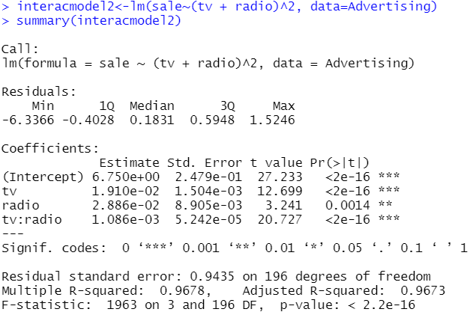

Testing for Interaction in Multiple Regression
+a include this variable a
a:b interaction between two variables, a and b.
a*b equivalent to a+b+a:b
(a+b)^2 equivalent to a+b+a:b
(a+b+c)^2 a+b+c+a:b+a:c+b:c
Notes:
To add the interaction predictor you can use a:b, colon symbol, Or the star symbol or the a plus b whole square. These three different formular gives you exactly the same results. You can play a bit at you end. But I posted results from R to prove what I said is true.

Slide 14
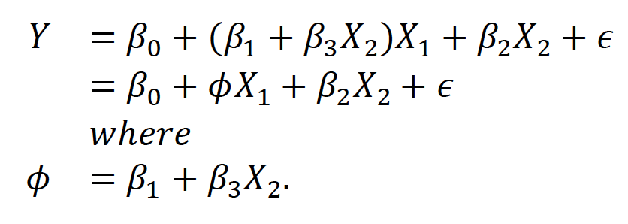

Interpreting Coefficients of Predictor Variables
Since 𝜙 changes with 𝑋₂, the effect of 𝑋₁ on 𝑌 is no longer constant: adjusting 𝑋₂ will change the impact of 𝑋₁ on 𝑌
14
Notes:
Here is another slide to show you why Influence of the independent variable X1 on the dependent variable Y is not consistent across X2 values! We can rewrite the interaction model in another formula. In this way, we can tell that the coefficient of X1 become beta1 + beta3 *X2.

Slide 15
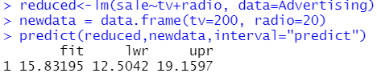
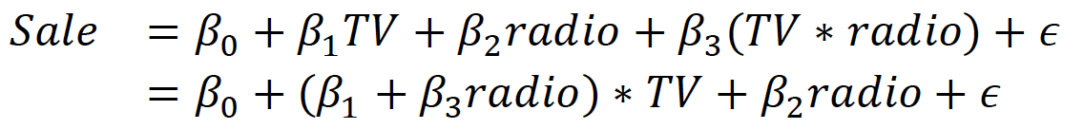

Interpreting Coefficients of Predictor Variables
Advertising data
We can interpret the coefficient $β_{1+}β_{3}$radio as: spending additional 1,000 dollars on TV advertising leads to an increase in sales by approximately $β_{1+}β_{3}$radio units.
15
Notes:
Back to our advertising data, from lecture 1, we concluded that newspaper is not essential and can be excluded from the model. So the optimal model we get from last lecture is sale ~ tv + radio.
Now how about adding an interaction term

Slide 16

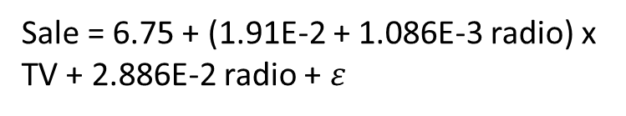
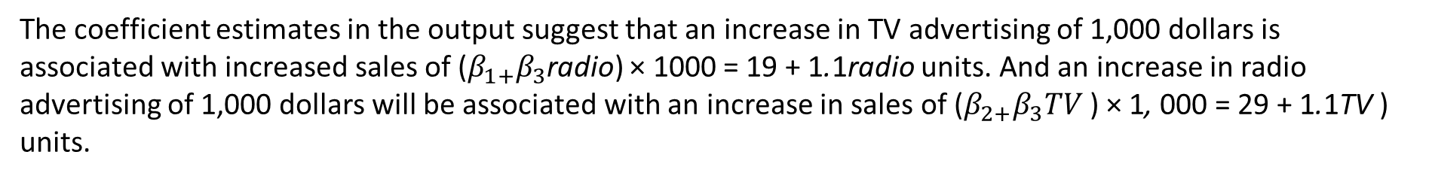
Interpreting Coefficients of Predictor Variables
Is it necessary to include the interaction term or not?
The results from the output strongly suggest that the model that includes the interaction term is superior to the model that contains only main effects.
Sale = 6.75 + (1.91E-2 + 1.086E-3 radio) x TV + 2.886E-2 radio + $ε$
The coefficient estimates in the output suggest that an increase in TV advertising of 1,000 dollars is associated with increased sales of ($β_{1+}β_{3}$radio) × 1000 = 19 + 1.1radio units. And an increase in radio advertising of 1,000 dollars will be associated with an increase in sales of ($β_{2+}β_{3}TV$ ) × 1, 000 = 29 + 1.1TV ) units.
16
Notes:
This slide show you the results of a new statistical model with interaction term between tv and radio.

Slide 17
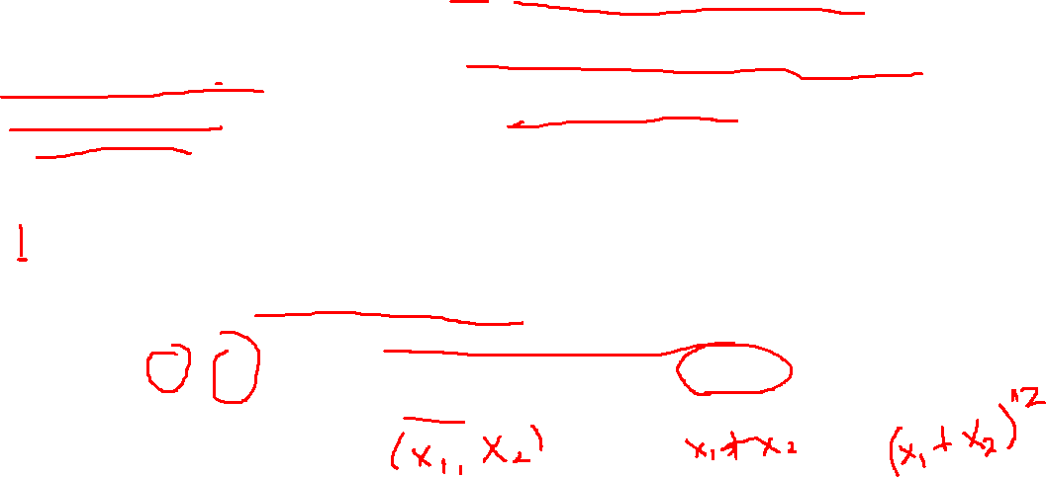
Interpreting Coefficients of Predictor Variables
In this example, the p-values associated with TV, radio, and the interaction term all are statistically significant and so it is obvious that all three variables should be included in the model. However, it is sometimes the case that an interaction term has a very small p-value, but the associated main effects (in this case, TV and radio) do not.
The hierarchical principle states that if we include an interaction in a model, we should also include the main effects, even if the p-values associated with principle their coefficients are not significant.
Caution
If the interaction between X1 and X2 seems important, then we should include both X1 and X2 in the model even if their coefficient estimates have large p-values.
The rationale for this principle is that if X1×X2 is related to the response, then whether or not the coefficients of X1 or X2 are exactly zero is of little interest. Also, X1 ×X2 is typically correlated with X1 and X2, and so leaving them out tends to alter the meaning of the interaction.
17

Slide 18

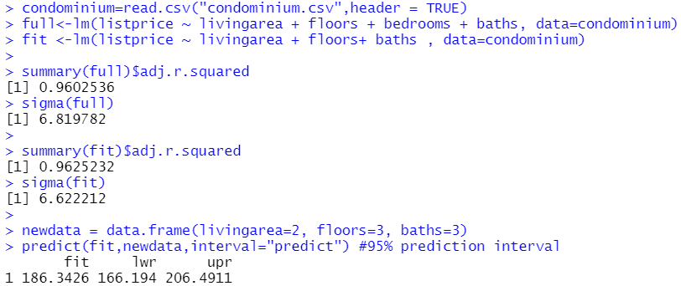


In class Practice Problem 4
From the condominium problem, do the data provide sufficient evidence to indicate that the interaction term
need to be added in the model? If you had to compare additive models with the interaction model, which
model would you choose? Explain.
L2.R
Notes:
Now. Let's do some hand-on activities and experiment with the concept "interaction."
Following on our previous problem of giving the asking price for a new listed condominium, we are now asking ….
Just for your information, we found that the bedroom does not play essential role in affecting condominium and we decide to exclude it from our statistical model. So you can start with a model with three predictors, which are livingarea, floors and baths.

Slide 19

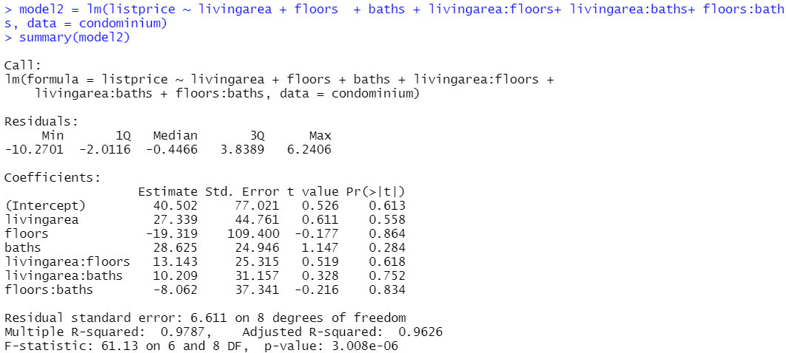
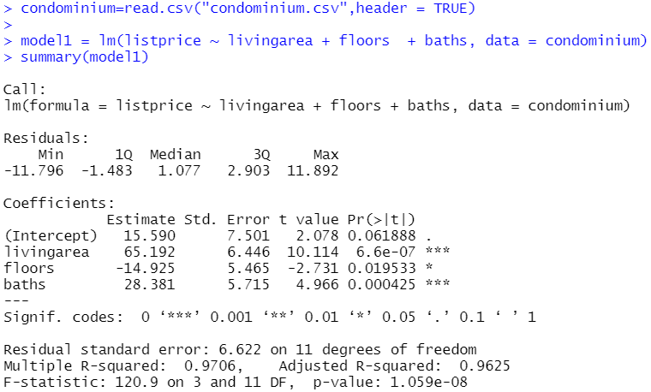

In class Practice Problem 4
Data does not provide sufficient evidence to indicate that the interaction term need to be added in the model.
Notes:
Here is our base model. Listprice ~ livingarea + floors+ baths. Then we three add interaction terms, livingarea:floors and ..
Summary of the this interaction model shows …
So, to conclude, …

Slide 20


In class Practice Problem 5
Data on last year’s sale (Y in 100,000s dollars) for 40 sales districts (sales.csv). This file also contains
promotional expenditures (X1: in 1,000s dollars),
the number of active accounts (X2),
the number of competing brands (X3) and
the district potential (X4, coded) for each of the districts (OMIT THIS VARIABLE FOR NOW)
1. Find the best fit additive model to predict sales using some or all of the variables X1,X2,X3 only.
2. Find the best fit model with interaction terms (if needed) using some or all of the variables X1,X2,X3
3. Which model would you choose? Explain.
4. Once you obtain the best fit model, interpret the regression coefficient for X3 (Hint: it will interact with another variable).
L2.R
Notes:
Let’s try to solve another problem now, this time, I hope you guys can take a bit of time to think about it, and I really encourage you to write down the R code by yourself. It helps to refresh your mind and understand questions.
Suppose we have data on last year’s sale, Y in 100 thousand dollars, as the response for 40 sales districts. You can find data in the sales.csv file.
Promotional expenditures: costs that are incurred in the process of marketing a product or service. The expenses may come from advertising and promotional activities.
District potential: residents living in some districts prefer buying a certain kind of product and residents in other district prefer buying another kind of product. We can use numbers to document these differences.
Our first question is asking you to find the best-fit additive model to ..
The second question asks you to add interaction terms on top of the best additive model you have built.
Then please tell me which model you think is the better.
In the end, please …
I will give you about 5 minutes to think about it then I will show you my answers.

Slide 21
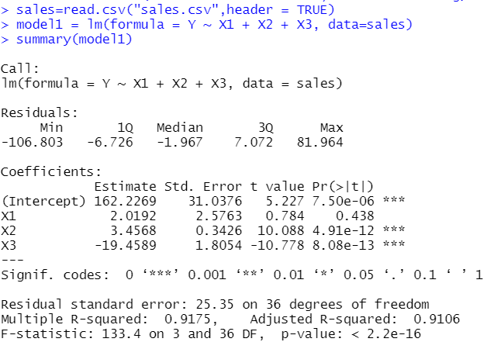
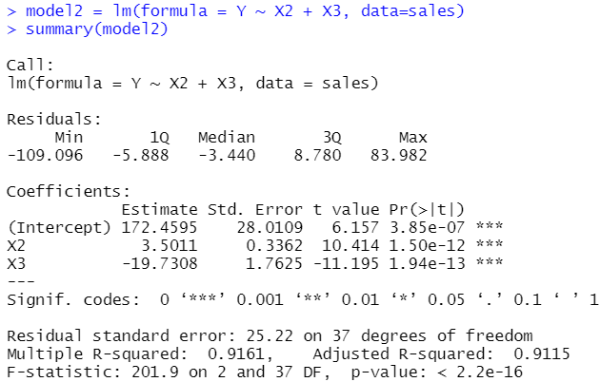
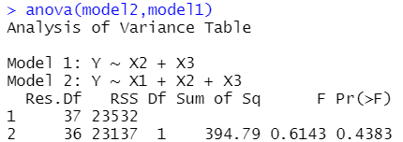

In class Practice Problem 5
Partial F-test
H0: coefficient of X1 =0
P value is not significant, H0 cannot be rejected. So, the coefficient for X1 can be considered as 0 and we exclude X1 from the model.
Notes:
Ok. Time’s up. Let’s see the answers together.
We start with a model with all predictors as we have no idea which predictor is useful and which is not.
Based on p value for coefficients for each predictor, we feel we can consider we can remove X1 as it has no star, which indicates its coefficient is not significantly different from 0. Then I build a second model without X1 and found that all coefficients for this model are significantly different from 0.
Additionally, I did a partial F-test. Partial F-test results indicate that we cannot distinguish coefficient of X1 from 0. Therefore we are safe to remove this predictor.
In a nutshell, The final additive model I built is y ~ x2 + x3.

Slide 22
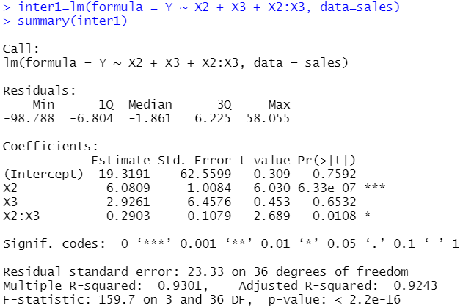
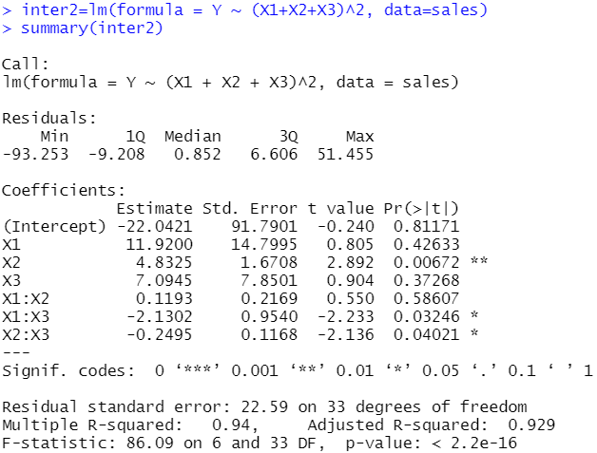
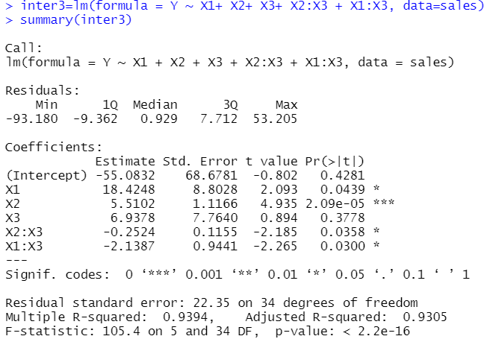
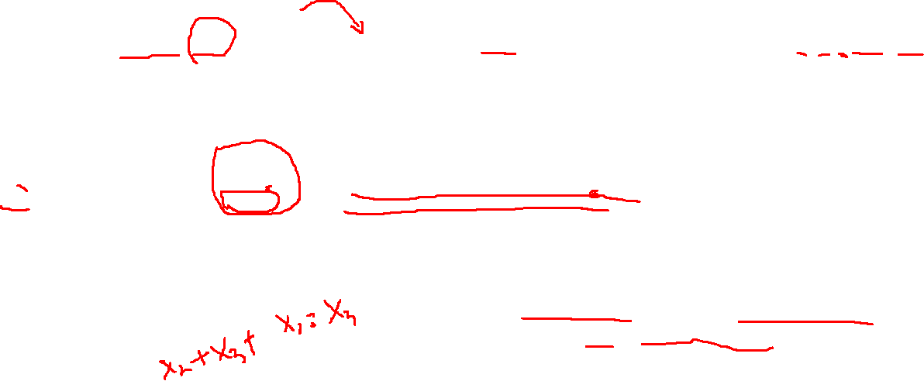
In class Practice Problem 5
ANOVA test suggested X1 can be exclude due to its insignificant p-values
However, interactions between X1 and X3 are significant and indicate it’s not appropriate to exclude X1.
We suggest you include all predictors when you build your first interaction model for your data.
Notes:
Ok, let’s now add interaction terms on top of the best additive model we just built. We found coefficients of X2, X2:X3 predictors have stars which means they distance far away from 0. So is this model our final interaction model?
Although we exclude X1, it does not hurt if we check the whether X1 has an interaction with X2 or X3. For the sake of completeness, we built an interaction model including X1 and checked all its coefficients. Strikingly, we found the coefficient of interaction predictor X1, X3 is significant.
Although …
So please forget the additive model we learn in the lecture 1 as it does not include interaction terms. Now, … is our baseline.
At last we refine the model a bit …

Slide 23
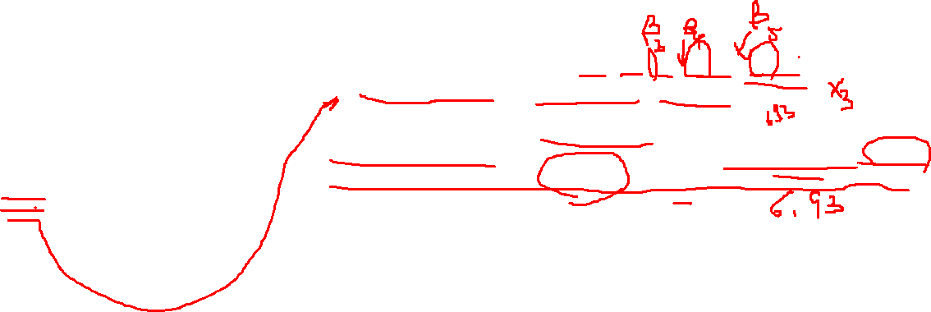
In class Practice Problem 5
The model I chose is inter3: Y ~ X1+ X2+ X3+ X2:X3 + X1:X3
The coeficiente of X3 is : (-2.1387 x X1-0.2524 x X2+18.4248).
The coefficient estimates in the output suggest that an increase in the number of competing brands of 1 unit is associated with increased sales of (-2.1387 x promotional expenditures – 0.2524 x active accounts + 18.4248) x 1 units.
However, promotional expenditures and activate accounts are both positive and in scale of thousands. Therefore, increase of brands of 1 unit is most likely to reduce sales.
In this example, the main effect of X3 is not significantly associated with sales. However, its interactions with X1 and X2 are significantly associated with sales. Therefore, we’d better include X1 in our model.
Notes:
We are done for building the statistical model with interaction terms. Now let’s do some interpretations.

Slide 24


Coffee break

Slide 25
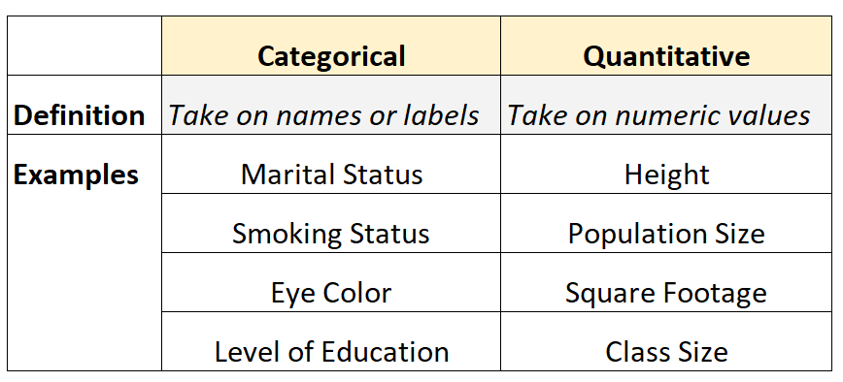

Multiple Regression with Qualitative (Dummy) Variable Models
Multiple regression models can also be written to include qualitative (or categorical) independent variables.
Qualitative variables, unlike quantitative variables, cannot be measured on a numerical scale. Therefore, we must code the values of the qualitative variable (called levels) as numbers before we can fit them in the model.
It’s easy to code ordinal variable as they have an inherent order. But how about nominal variables? Does it make sense to code 0 for blue eye colour, 1 for green eye colour and 2 for hazel eye colour?
Nominal
Ordinal
The categories of a nominal variable have no inherent or natural order
The categories of a nominal variable have no inherent or natural order
Notes:
Now let’s sheet gear a bit. In previous cases, you have continuous or so-called quantitative variables. But in real life, we have qualitative/categorical variables. Here is a table which gives some ideas about categorical and quantitative variables.
Nominal variables: is a categorical variable with two or more categories but no inherent order or rank.
Ordinal variables: have an inherent or natural order.
Marital status (“married”, “single”, “divorced”)
Smoking status (“smoker”, “non-smoker”)
Eye color (“blue”, “green”, “hazel”)
Level of education (e.g. “high school”, “Bachelor’s degree”, “Master’s degree”)
How to involve them in statistical models? Coding them

Slide 26
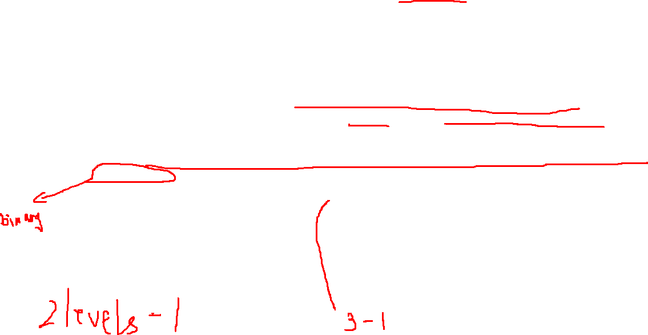
Multiple Regression with Qualitative (Dummy) Variable Models
Because categorical predictor variables cannot be entered directly into a regression model and be meaningfully interpreted, some other methods of dealing with information of this type must be developed.
In Generally, a categorical variable with k levels will be transformed into k −1 variables with two levels. For example, if a categorical variable had six levels, then five dichotomous variables could be constructed that would contain the same information as the single categorical variable.
The process of creating dichotomous variables from categorical variables is called dummy coding. These dichotomous variables are called dummy variables. The simplest case of dummy coding is when a categorical variable has two levels by assigning zero and one to the variable.
Smoking status | X1
Smoker | 1
non-smoker | 0
Eyes colour | X1 | X2
Blue | 1 | 0
Green | 0 | 1
Hazel | 0 | 0

Slide 27
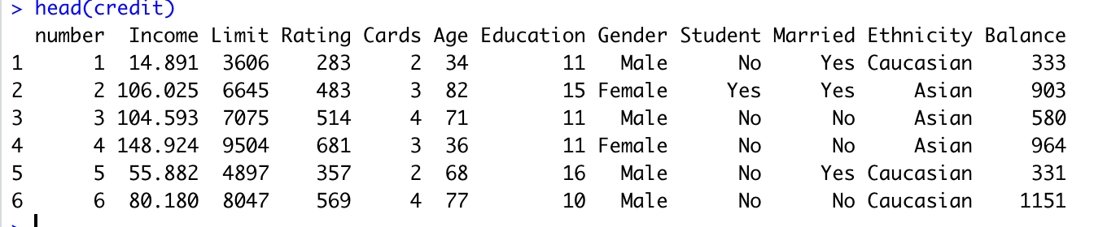

Multiple Regression with Qualitative (Dummy) Variable Models
The Credit data set records balance (average credit card debt for a number of individuals) as well as several quantitative predictors: age, cards (number of credit cards), education (years of education), income (in thousands of dollars), limit (credit limit), and rating (credit rating).
In addition to these quantitative variables, we also have four qualitative variables: gender, student (student status), status (marital status), and ethnicity (Caucasian, African American or Asian). Data are provided in credit.csv file.
Suppose that we wish to investigate differences in credit card balance between males and females. Based on the gender variable, we can create one dummy variable (2-1=1) with 0 as male and 1 as female.
27
Notes:
Now let’s have a hands-on example. I am not sure if you still remember it or not, but when you apply for a credit card, they will ask you a bunch of questions such as age, yearly income, gender, education, marital status, etc. This information is used to predict your card limit.
So here we have credit data set records balance and …

Slide 28
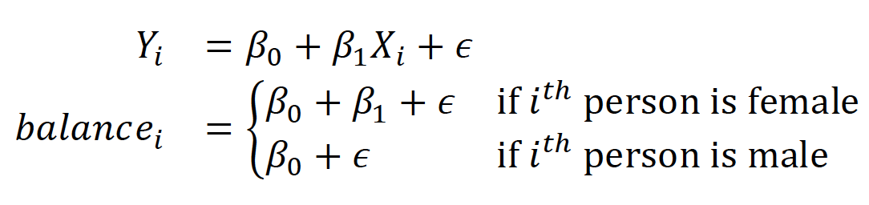

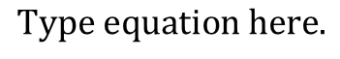
Multiple Regression with Qualitative (Dummy) Variable Models
Gender | X1
Male | 1
Female | 0
Notes:
Here are the dummy variables tables.

Slide 29
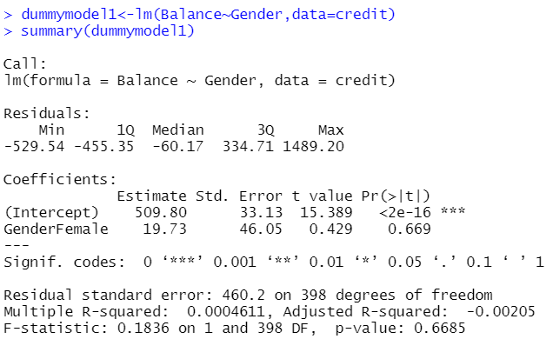
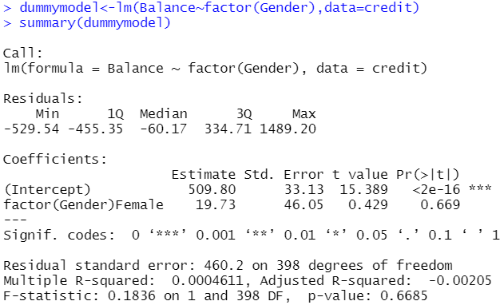

Multiple Regression with Qualitative (Dummy) Variable Models
factor() : command will make sure that R knows that your variable is categorical. This is especially useful if your categories are indicated by integers, otherwise function lm() might interpret the variable as continuous.
29
Notes:
Here are the code. The difference between left and right is on the right we use the factor function to make sure R interprets Gender variables as categorical variables.

Slide 30
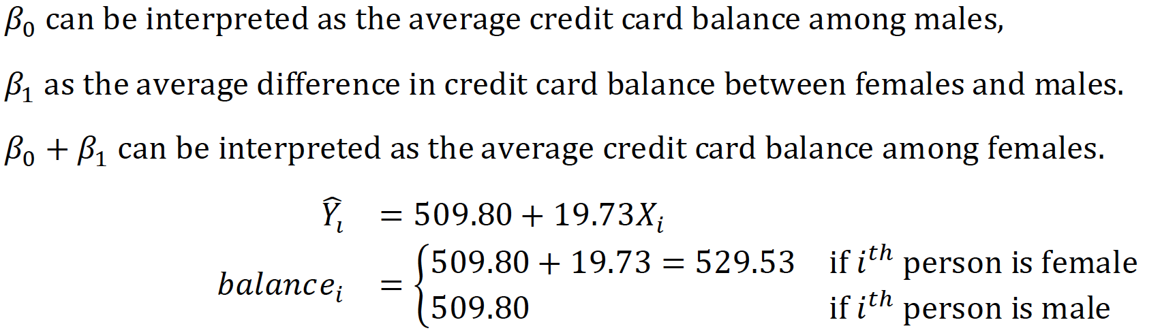

Interpreting coefficients of predictor variable
From the output, the coefficient estimates and other information associated with the model are provided. The average credit card debt for males is estimated to be 509.80 dollars whereas females are estimated to carry 19.73 in additional debt for a total of 509.80 + 19.73 = 529.53 dollars.
However, we notice that the p-value (0.669) for the dummy variable is very high. This indicates that there is no statistical evidence of a difference in average credit card balance between the genders.
30
Notes:
Here comes the interpretations of coefficients.

Slide 31


In class Practice Problem 6
Suppose that we wish to investigate differences in credit card balance between marital status. Based on the Married variable, we can create a dummy variable which 0 is NO and 1 is Yes.
Create a simple linear regression model to predict the credit card balance by using the Married variable.
How much is the average credit card debt for an unmarried person.
What is the difference in debt between a married and single person.
Ignore the individual t-test output.
L2.R
Notes:
Now, you know what dummy coding and how to convert categorical variables into dummy variables. Let's get some hands-on practice.
Let’s continue using credit card balance data.

Slide 32
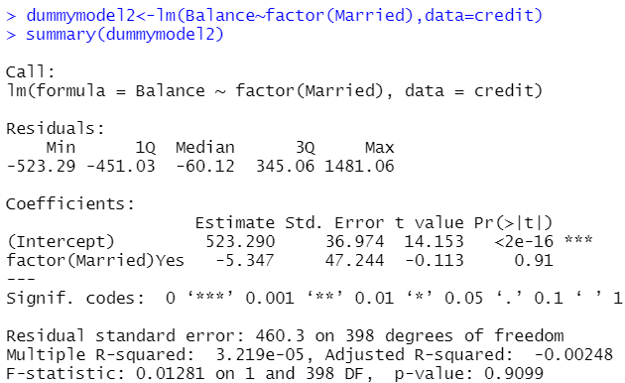

In class Practice Problem 6
The average credit card balance for an unmarried person is 523.29. The average is 523.290-5.347=517.943 for a married person.
L2.R
Notes:
Here are the answers.

Slide 33
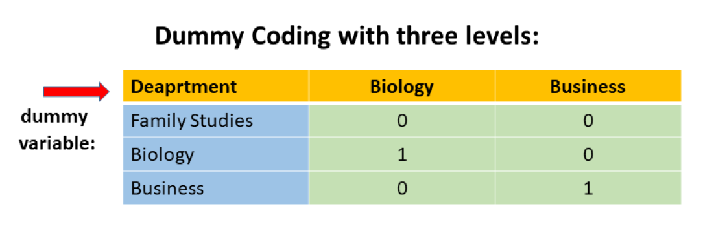

Dummy Coding with three levels
For example, there is always a certain curiosity and controversy surrounding professor’ salaries and whether they are overpaid or not paid enough. A university would like to study the effects of ranks and department on the salaries. 30 observations were randomly chosen from 3 different departments. The data are provided in salary.csv data file.
Notes:
I hope we are Ok up to this point. Let’s know look at dummy coding for a categorical variables with three levels. In that case, we have to use two dummy variables.

Slide 34
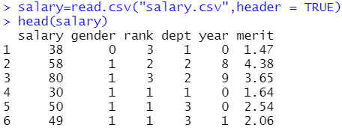

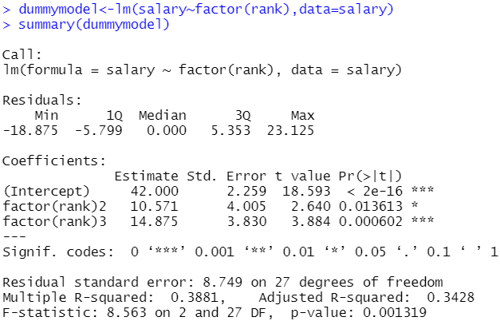
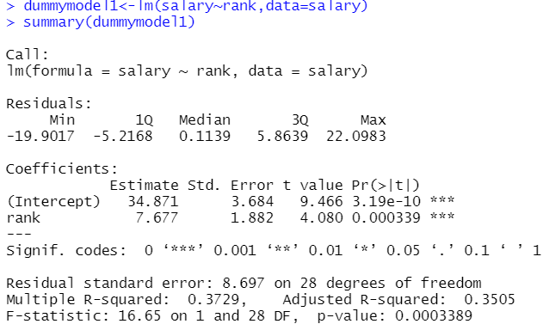

Dummy Coding with three levels
Dept= Department (1 =Family Studies, 2 =Biology, 3 = Business).
! Coding variable as qualitative (categorical) or quantitative (continuous) leads to different regression results!
34
Notes:
So, again, we load the salary.csv into R working space. We use head function to check first lines of this dataset. We then build our model.

Slide 35
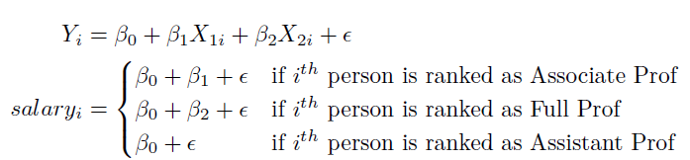
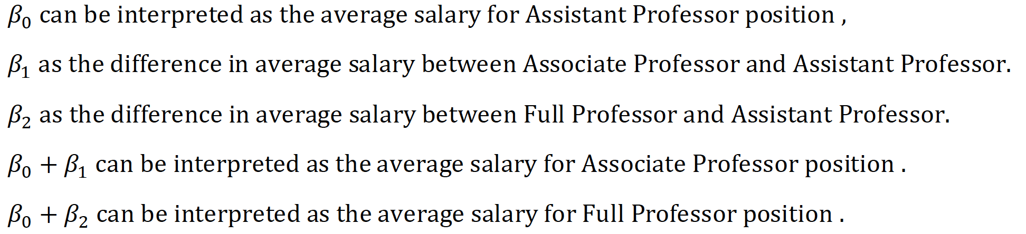

Interpreting coefficients of predictor variables
35
Notes:
Building a statistical model rank categorical data show that two dummy variables from rank all significantly associated with professor’s salary in the university.
With this model on hand, we can do some interpretation about professor’s salary.

Slide 36


In class Practice Problem 7
There is always a certain curiosity and controversy surrounding
professors ’ salaries and whether they are overpaid or not paid
enough. A university would like to study the effects of ranks and
departments on salaries. 30 observations were randomly chosen
from 3 different departments. The data are provided in the
salary.csv data file. Dept= Department (1=Family studies,
2=Biology, 3=Business).
Instead of the rank variable, practice how to interpret the department variable.
Can you also try to interpret rank and department together?
L2.R
Notes:
Now it’s your turn to do some hand on exercises. Please continue using the processors’ salary example, instead of the rank variable, please practice how to interpret department variable. Can you interpret rank and department together?
How about 5 minutes and then let’s check answers together.

Slide 37


In class Practice Problem 7
$$y_{i}=β_{0}+β_{1}X_{i1}+β_{2}X_{i2}$$
Average salary for professor from Family studies (1) is 42.25
Average salary for professor from biology (2) is 42.25+7.75=50
Average salary for professor from biology (2) is 42.25+12.35=54.6
L2.R

Slide 38


In class Practice Problem 7
 | x1 | x2
Assistant | 0 | 0
Associate | 1 | 0
Full | 0 | 1
 | x3 | x4
Family studies | 0 | 0
Biology | 1 | 0
Business | 0 | 1
L2.R

Slide 39

Take away messages
Statistics:
Interactions: x1:x2 or (x1+x2)^2 or x1*x2
Dummy coding: the number of variable = the number of category -1
Interpretation of coefficients
Code:
lm(y ~ x1+x2+(x1+x2)^2)
lm(y ~ factor(x1))
Notes:
To summarize today’s lecture, we are aware that interactions between some variables can cause great effect on response. So we will include interactions between predictors. We also learned about dummy coding, an efficient way to transfer categorical data into numerical values and take them into statistical models. We've also gone through the explanations of these coefficients in depth so you know what they mean. The R function that I hope you can learn by heart are 1) a plus b whole square 2) factor

Slide 40

Thank you
Questions OR Comments?
Slack channel: section2-course-documents
Email: qing.li2@uclagary.ca

